Slide 1

COMP8270 / PROGRAMMING FOR ARTIFICIAL INTELLIGENCE
The UK’s European university

Slide 2
overview:
Artificial Neural Networks (ANN)
ANNs as Functions
Introduction to Keras

Slide 3
Artificial Neural Networks

Slide 4
Artificial Neural Networks (ANN)
Biologically inspired
Digital computers simulate biological neural networks
The most famous early work is by Hebb (1949)
Numerically unstable
Rosenblatt postulated the “perceptron” (1958)
Almost all modern training methods are derived from a 1986 paper, (Rumelhart, Hinton and Williams)
Error Backpropagation

Slide 5
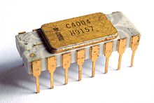
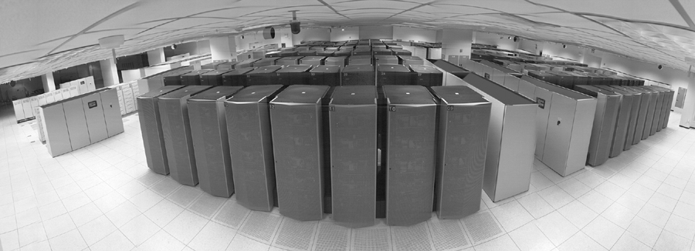
What Made ANNs Feasible?
Intel 4004 | IBM ASCI White | Mac Studio
First CPU | Fastest Supercomputer | Home Computer
1971 | 2001 | 2022
$60 | $110,000,000 | $4,000
2,300 Transistors | 123,000,000,000 Transistors | 114,000,000,000 Transistors
N/A | 12.3 TFLOPS | 20 TFLOPS

Slide 6
Feed Forward ANN
An ANN can be viewed as a graph
Nodes (Neurons) in the graph are connected by edges
Edges are weighted
Thus, nodes ignore some connections, and believe others
The weights determine the behaviour of the ANN
The ANN is a function
y = f (x) = ANN (x)
There is an input and an output
The ANN is trained by presenting examples
The ANN “learns” the function from experience
Weights are discovered during learning

Slide 7
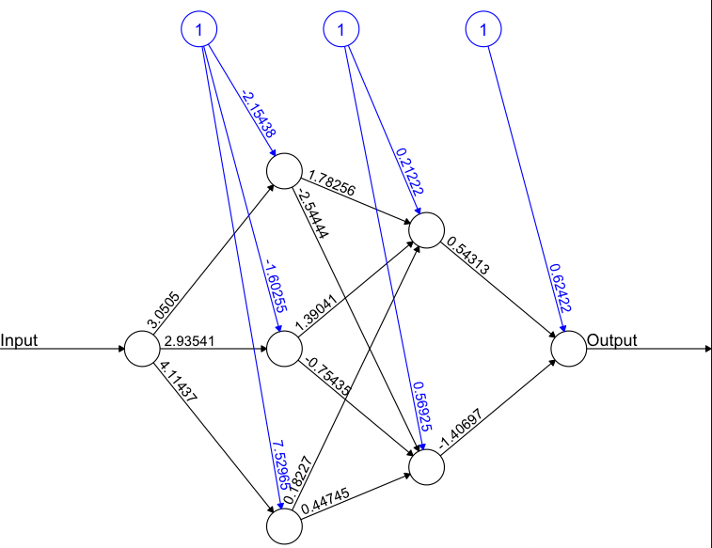
ANN Example (sine)
All weights are learnt
1.1
2.1
x
x
1.2
y
y
2.2
1.3

Slide 8
ANNs as Functions

Slide 9
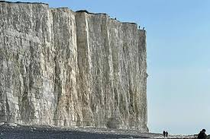
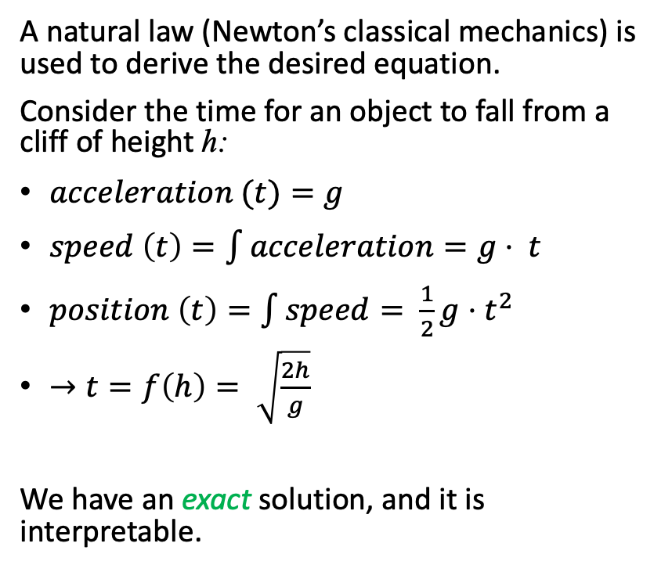
Building Functions Prior to ANNs
A natural law (Newton’s classical mechanics) is used to derive the desired equation.
Consider the time for an object to fall from a cliff of height h:
$acceleration (t)=g$
$speed \left(t\right)=\int{acceleration}=g⋅ t$
$position \left(t\right)=\int{speed}= \frac{1}{2}g⋅t^{2}$
$→t=f\left(h\right)= \sqrt{\frac{2h}{g}}$
We have an exact solution, and it is interpretable.

Slide 10
The ANN Approach: Learning
Instead of deriving an equation for the function we collect values:
Training Set = { (x₁, y₁), … ,(x_{N}, y_{N}) }
or { (input₁, output₁) … (input_{N}, output_{N}) }
or { (question₁, answer₁) … (question_{N}, answer_{N}) }
Recall the cliff example:
Training Set = { (height₁, time₁), … ,(height_{N}, time_{N}) }
Training consists of presenting the training set to the ANN until the error is acceptable.
It ”learns” the function empirically.
This is an example of supervised learning.

Slide 11
Learning Based on Training
Training an ANN to build a continuous function is “regression”
Regressing on extant data or observations
For a function to be correct it must be constrained.
The function for the orbit of a satellite is constrained by the law of gravity.
The idea is to “teach” an ANN by showing it examples until is learns from them.
The examples are presented repeatedly until the error is acceptable:
attempt = ANN (x_{i})
Error (attempt – y_{i}) < 𝜀

Slide 12
When is an ANN Appropriate?
Throughout history people have derived equations from natural laws.
Celestial motion
Landing people on the moon
Design of bridges, CPUs and atomic bombs
For over 3 millennia natural laws have been sufficient.
Many modern problems are constrained empirically.
What about:
movie suggestion = f (list of movies, age, income)
is a kitten? = f (jpeg)
VIX.Open = f (VIX history)
Newton and Einstein will not help here.
Only the empirical approach is viable.

Slide 13
Summary
An ANN is a graph of nodes connected with weighted edges.
Weights determine what the ANN does.
They are learnt during training of the ANN.
ANNs are trained with example data:
Training Set = { (x₁, y₁), … ,(x_{N}, y_{N}) }
Problems where the only constraints available are training data suggest using an ANN.
The function we want is unknown and specified empirically.

Slide 14
Introduction to Keras

Slide 15
Keras
Keras is a Python interface to TensorFlow
Developed by Google
TensorFlow is an ANN library
Developed by Google
TensorFlow requires drivers, such as CUDA, to access the raw hardware.
GPU
CPU
It is a high-level library for building machine learning applications.

